Slide 1
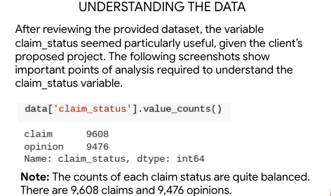
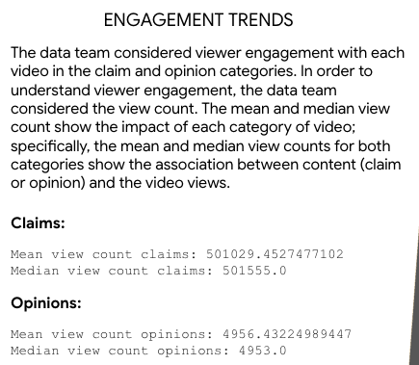
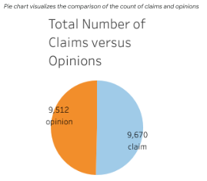
Executive Summary
Milestone 2: Inspection and preparation of DataFrame
The TikTok data team seeks to develop a machine learning model to assist in the classification of claims for user submissions. To begin, the data team needs to organize the raw dataset and prepare it for future exploratory data analysis.
The data team performed a preliminary investigation of the dataset and were able to verify ample records present of each category along the classification axis ‘claim_status’.
Additional calculated fields were created to aid in the exploratory analysis to come.
The data team has identified variables worthy of exploration to possibly use in the model training.
Possible independent variables identified: video_duration, video_view_count
There is a fairly balanced ration of claims versus opinions records. This should be kept in mind as we move into exploratory analysis, and has the potential to yield good training data.

